Slide 1
Querying Workflow Provenance
Susan B. Davidson
University of Pennsylvania
Joint work with Zhuowei Bao, Xiaocheng Huang and Tova Milo

Slide 2
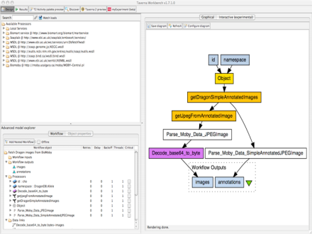
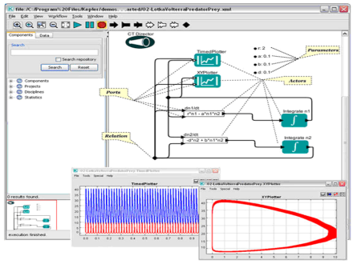
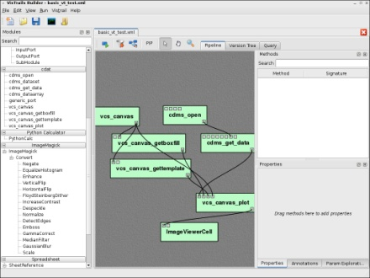
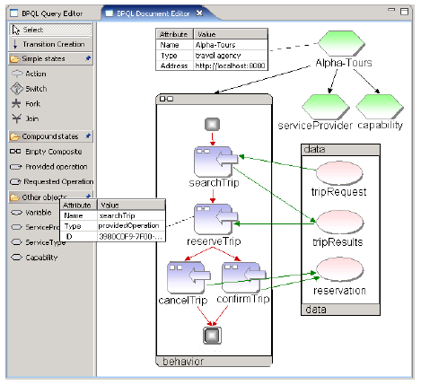
Provenance in Scientific Workflows
Scientific workflow systems
Automate the execution of scientific workflows
Capture the provenance at various levels of details
Provenance graphs are currently captured by these systems as DAGS:
Taverna
[Hull+06]
Kepler
[Altintas+04]
VisTrails
[Callahan+06]
BP-QL
[Beeri+06]
d2
d7
d8
M2: Check
Annotation
M3: Format
Annotation
d3
d1
M1: Split
Entry
M4: Run
Alignment
M5: Format
Alignment
M6: Build
Phylo. Tree
d9
d4
d5
d6

Slide 3
and I mean that provenance is “captured”…

Slide 4
How can we “release” provenance?
Since provenance is a DAG, can use any graph query language
E.g. ProQL [Karvouranakis+ SIGMOD’10]
Provenance Challenges showed a number of desired queries which should be optimized for.
Many were simple reachability queries
“Identify the data sources that contributed some data leading to the production of publication p”.
Others required regular path queries
“Find all publications p that resulted from starting with data of type x, then performing a repeated analysis using either technique a1 or technique a2, terminated by producing a result of type s, and eventually ending by publishing p.”
Provenance can also be very large, so we need “views”
Zoom-in/Zoom-out [Biton+ ICDE’08], [Amsterdamer+ VLDB’11]

Slide 5
Overview
The problem
How to efficiently answer reachability and regular path queries over provenance graphs representing workflow executions?
The approach
Reachability labeling
The setting
Dynamic provenance graphs
Derivation-based model of executions

Slide 6
Reachability Labeling
Given a graph, we assign each node a label such that using only the labels of any two nodes, we can decide if one can reach the other.
Goal: design a compact and efficient labeling scheme
Labeling scheme should also be dynamic and persistent.
d
l(d1)
l(d2)
Interval encoding [Santoro+85]
(1, 9)
(2, 7)
Labeling function
Decoding predicate
(5, 8)
(3, 5)
(4, 6)
l(d)
Yes iff d1 reaches d2
Test interval containment
Logarithmic label size
Linear construction time
Constant query time
Notes:
We will base the labeling on a sequence of node replacements

Slide 7
“Surprising” things
Compact and efficient labeling is achievable for DAGs generated by workflow specifications
We can efficiently implement regular path queries using labeling.

Slide 8
Roadmap
Introduction
Workflow Model
Reachability Labeling Scheme
From Reachability to Regular Path Queries
Conclusions
Notes:
This is an outline of the rest of this talk. (Click) We start by introducing the workflow models.

Slide 9
Grammar-Based Workflow Model
Specification and execution (a.k.a. run or provenance graph)
Specification is small (a “constant”), execution is big (due to repeated parallel/sequential behaviors)
Specification = context-free graph grammar
Formally, G = (Σ, Δ, S, P)
Σ: a set of atomic modules
Δ: a set of composite modules
S: start module
P: a set of graph-based productions of form M := W
All possible executions = context-free graph language
Formally, L(G) = { R in Σ* | S =>* R }
terminals
variables
composite module
start variable
sub-workflow
Notes:
Our workflow model has two components. A workflow specification describes the design of a workflow; and a workflow execution describes a particular run of the given specification. So we also call it a workflow run or a provenance graph.
(Click) Formally, we define a workflow specification as a context-free graph grammar. For those of you who are not familiar with the context-free graph grammar, you can just think about the well-known context-free string grammar. They are extremely similar. A context-free graph grammar has four components. (Click) Sigma is a set of atomic modules, which correspond to terminals. (Click) Delta is a set of composite modules, which correspond to variables. (Click) S is a start module, which corresponds to the start variable. (Click) Finally, P is a set of graph-based productions. Recall that a string-based production would replace a variable with a string. Here, a graph-based production would replace a composite module M with a sub-workflow W.
(Click) Given the specification, the set of all possible executions is naturally defined as the language of the corresponding grammar. Basically, to get an execution, we begin with the start module, and repeatedly apply graph-based productions until all the composite modules are replaced. Finally, we get a large graph with only atomic modules, which describes the lowest-level provenance graph.
(Click) In this grammar-based workflow model, we can naturally define a workflow view by restricting the productions to a subset of composite modules. Such a view is simply specified by a subset of composite modules. Note that our view is first defined over the specification, and then automatically projected onto its associated executions.

Slide 10
Example: Workflow Specification
Alternative productions
Recursive productions
Notes:
Let’s look at an example of a workflow specification.
(Click) M1 is the start module. (Click) We have a production that replaces M1 with a sub-workflow W1. Basically, W1 describes the detailed implementation of M1. (Click) Similarly, we have another production that replaces M2 with W2. (Click) and a production that replaces M4 with W4, (Double click) so on and so forth.
Such a hierarchical model is naturally driven by the way people used to create workflows. Since building a complex workflow from scratch takes enormous efforts, a common practice is to reuse existing workflows as composite modules, and use them to build new workflows.
(Click) Note that in a workflow specification, we may have alternative productions. For example, the production from M5 to W4, and the production from M5 to W5. During the execution, only one of them will be selected.
(Click) We may also have recursive productions. In this example, the production from M5 to W4 is recursive. Combining it with the other production from M5 to W5, we actually get a loop over module M10. In general, recursive productions capture possible repeated executions of sub-workflows.

Slide 11
Example: Workflow Execution
Specification :
An execution :
Notes:
Let’s look at an example of a workflow specification.
(Click) M1 is the start module. (Click) We have a production that replaces M1 with a sub-workflow W1. Basically, W1 describes the detailed implementation of M1. (Click) Similarly, we have another production that replaces M2 with W2. (Click) and a production that replaces M4 with W4, (Double click) so on and so forth.
Such a hierarchical model is naturally driven by the way people used to create workflows. Since building a complex workflow from scratch takes enormous efforts, a common practice is to reuse existing workflows as composite modules, and use them to build new workflows.
(Click) Note that in a workflow specification, we may have alternative productions. For example, the production from M5 to W4, and the production from M5 to W5. During the execution, only one of them will be selected.
(Click) We may also have recursive productions. In this example, the production from M5 to W4 is recursive. Combining it with the other production from M5 to W5, we actually get a loop over module M10. In general, recursive productions capture possible repeated executions of sub-workflows.

Slide 12
Derivation-based view of execution

Slide 13
Fine-Grained Dependencies
Modules may have multiple inputs and output (we have assume single input/output so far).
Typical assumption: Black-box dependencies
Every output depends on every input.
Creates problems for composite modules.
In a fine-grained model, an output depends on a subset of inputs.
M3
d1
d4= d1
d2
d5= d1+d2
Notes:
For example, consider a workflow execution with two modules M1 and M2. The dashed edges inside modules indicate the input-output dependencies.
(Click) In a high-level view of this workflow, we will see only one composite module M3 with two inputs d1, d2 and two outputs d4, d5. Now consider two types of views.
(Click) In an abstraction view, we only want to hide details of M3, and therefore users should still be able to see the true dependencies between inputs and outputs of M3.
(Click) However, in a security view, we may want to blur the true dependencies between inputs and outputs of M3 in order to preserve module privacy. In this example, we simply tell users that every output of M3 depends on every input.
(Click) Now consider a reachability query that asks if d4 depends on d2. The answer would be “no” for the abstraction view, but “yes” for the security view. As we can see from this example, when we have views with fine-grained dependencies, the answer to a reachability query may alter in different views.

Slide 14
Roadmap
Introduction
Workflow Model
Reachability Labeling Scheme
From Reachability to Regular Path Queries
Conclusions
Notes:
This is an outline of the rest of this talk. (Click) We start by introducing the workflow models.

Slide 15
Reachability Labeling
Labels represent the sequence of node replacements (derivations) that produced the module execution
“compressed” parse tree, whose height is proportional to the size of the workflow grammar

Slide 16
Testing Reachability
Problem Statement: Given two nodes (x,y) in an execution is y reachable from x?
a node in the execution is a leaf in the compressed parse tree
Method (roughly speaking): Look for least common ancestor of nodes, and examine the specification to see if the node-types are reachable.
Is b:3 reachable from c:1?
Is d:1 reachable from a:1?

Slide 17
Roadmap
Introduction
Workflow Model
Reachability Labeling Scheme
From Reachability to Regular Path Queries
Conclusions
Notes:
This is an outline of the rest of this talk. (Click) We start by introducing the workflow models.

Slide 18
Idea: Intersect Query with Execution
Query _*e_* as a DFA:
Sample execution:
Fine-grained representation of sample execution for _*e_* :

Slide 19
Regular Path Query becomes Reachability Query
Is b:1 reachable from c:1 via _*e_* ?
Reachable?

Slide 20
But labeling is dynamic…
Executions are not query-dependent, labels cannot be changed once they are generated
Labels represent reachability
Intersect the specification with query at query-time

Slide 21
Revisiting example
Is b:1 reachable from c:1
via _*e_* ?

Slide 22
Some caveats
Workflow grammar must be strictly linear-recursive
All recursions are node-disjoint
The query must be safe with respect to the specification
Connections between input/output “states” must be stable for any execution of each composite module
Example: Query R1= _*e_* is safe, but R2= e is unsafe.

Slide 23
Conclusions
Since workflow provenance graphs are derived from a specification, there is additional information that can be used to develop compact and efficient labeling schemes
To answer (safe) regular path queries:
Create reachability labels at execution time
Intersect query with the specification at query time
Combine to answer query
Queries which are not safe can be broken into smaller, safe subqueries and their results joined together
These ideas can also be used to answer queries over views of fine-grained workflows.

