Slide 1

The Webdam Project &
Distributed knowledge management in Webdam
Serge Abiteboul
INRIA Saclay & ENS Cachan

Slide 2
Introduction
1

Slide 3
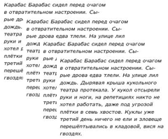


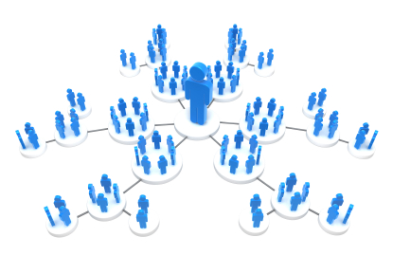
The Web
hypertext
universal library of text
and multimedia
personal/private data
social data

Slide 4
A typical Web user’s data
What kinds of data?
  data: photos, music, movies, reports, email
  metadata: photo taken by Alice in Paris on ...
  ontologies: Alice’s ontology and mapping with other ontologies
  localization: Alice’s pictures are on Picasa, back-ups are at INRIA
  security: Facebook credentials (Alice, 123456)
  annotations: Alice likes Elvis’ website
  beliefs: Alice believes Elvis is alive
  external knowledge: Bob keeps copies of Alice’s pictures
  time, provenance, ...
All kinds

Slide 5
A typical Web user’s data
What kinds of data?
Where is the data?
  laptop, desktop, smartphone, tablet, car computer
  mail, address book, agenda
  Facebook, LinkedIn, Picasa, YouTube, Tweeter
  svn, Google docs
  also access to data / information of family, friends, companies associations
All kinds
Everywhere

Slide 6
A typical Web user’s data
What kinds of data?
Where is the data?
What kind of organization?
  terminology: different ontologies
  systems: personal machines, social networks
  distribution: different localization
  security: different protocols
  quality: incomplete / inconsistent information
All kinds
Everywhere
Very heterogeneous

Slide 7
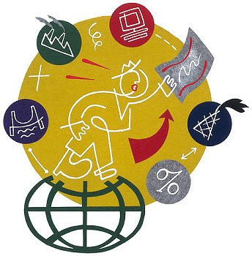
A typical Web user’s data
What kinds of data?
Where is the data?
What kind of organization?
A typical user
  Overwhelmed by the mass of information
  Cannot find the information needed
  Is not aware of important events
  Cannot manage/control how others access and use his/her own data
All kinds
Everywhere
Very heterogeneous

Slide 8
Solution: build his personal knowledge base
Option 1 – that he should not like
  Bring all his data and the relevant data of his friends & colleagues into a unique system
  Build his knowledge base in this unique system
Option 2 – Webdam thesis
  Keep the data where it is
  Organize the collaboration between all systems that have some data of interest

Slide 9
Probabilities
Distributed
Workflow
Inconsistent
Imprecise
Open
Webdamlog
Active-XML
Collaborative

Slide 10
Organization
Introduction
Distributed knowledge management
  The world is open: Active xml
  The world is distributed: Webdamlog
  Access control in Webdamlog
Uncertainty
Workflows
Webdam achievements
Serge
Pierre
Victor

Slide 11
Distributed knowledge base
2

Slide 12
Active XML = evolving trees
XML documents with embedded Web service calls
  Distributed data
  Intentional data
  Dynamic data
Exchange streams of Active XML documents
Efficient distributed query evaluation
Query/
Updates
Updates
AXML document
streams

Slide 13
Some works around Active xml
Verification of Active XML systems, Abiteboul, Segoufin, Vianu, PODS’08, TODS’09
Optimization Active XML systems, Abiteboul, ten Cate, Katsis, ICDT’11 and JCSS’13
Distributed XML Design, Abiteboul, Gottlob, Manna, PODS’O9, JCSS’11

Slide 14
Webdamlog
Extends datalog
  negation, updates, distribution, delegation, time
Influenced by
  Active XML - for distribution & intentional data
  Dedalus (UC Berkeley) - for time & implementation
Peer and relation names are data
Delegation: possibility to send a rule to another peer
    Basis for distributed computing`
    Basis for learning knowledge rules

Slide 15
Peer and relation names are data
$message@$peer($name, “Happy birthday!”) :-
    today@my-iphone($d/$m/$y),
    birthday@my-iphone($name, $message, $peer, $d/$m)
Extensional facts:
  today@my-iphone(6/3)
  birthday@my-iphone(Manon, sendmail, gmail.com, 6/3)
  sendmail@gmail.com(Manon, “Happy birthday”)

Slide 16
Some works around Webdamlog
The Webdamlog language, Abiteboul, Bienvenu, Galland, Antoine, PODS’11
The Web as a Distributed Knowledge Base, Abiteboul, Antoine, Stoyanovich, ICDE’12
Access Control in Webdamlog, Abiteboul, Antoine, Miklau, Stoyanovich, Zaychik-Moffitt, DBPL’13

Slide 17
Series of implementations of distributed database systems
Active XML evaluation: Omar Benjelloun
Active XML optimization: Spyros Zoupanos (Ioana Manolescu)
Webdam Exchange: Alban Galand
  Based on XML data
  Application in Java
Webdamlog: Emilien Antoine
  Based on relational data
  Application in Webdamlog
  Datalog engine: Bud of UC Berkeley

Slide 18
Access control in Webdamlog
2.1

Slide 19
Who can read a fact ? – default
Extensional relations: if you have read privilege to the relation
Intensional relations:
  if you have read privilege to the relation &
  if you can read all the tuples that have been used to create this fact – provenance of the fact

Slide 20
Fine grain access control
[at Alice] allPhotos@Alice($f) : alicePhotos@Alice($f)
[at Bob] allPhotos@Alice($f) :- bobPhotos@Bob($f)
allPhotos@Alice is intensional
Sue sees only the photos of Alice
Lili sees everything

Slide 21
Overwriting the default for intensional data
Let us change the rule to:
[at Alice] allPhotos@$x($f) :- alicePhotos@Alice($f), friends@Alice($x)
Issue: you can read the photos only if you also have read privilege to friends@Alice

Slide 22
Overwriting the default for intensional data
[at Alice] allPhotos@$x($f) :- alicePhotos@Alice($f), [hide friends@Alice($x)]
Hide: block the provenance from friends@Alice

Slide 23
Issues with non local rules
[at Bob]
  message@Sue(“I hate you”) :- date@Alice(d)
  aliceSecret@Bob(x) :- date@Alice(d), secret@Alice(x)
Ignoring access rights, by delegation, this results in:
[at Alice]
message@Sue(“I hate you”) :- date@Alice(d)
aliceSecret@Bob(x) :- date@Alice(d), secret@Alice(x)

Slide 24
Default solution: sand box
We run the rule at Alice in a Sandbox
We use the access rights of Bob
  Second rule does not succeed in sending secrets
The message specifies that this is done at Bob’s request
  Requires authentication/signatures
Alternative: delegation without sandbox

Slide 25
Achievements
5

Slide 26
The dream team: the young ones
Antoine Amarilli PhD student at Telecom ParisTech
Yael Amsterdamer PhD student at Tel Aviv
Émilien Antoine PhD student at Paris Sud U.
Pierre Bourhis PhD, now at CNRS & Lille U.
Alban Galland PhD, now at Ministry of economy…
Evgeny Kharlamov PhD, now at Oxford University
Wojciech Kazana PhD, now at UCSD
Bogdan Marinoiu PhD, now at SAP
David Montoya PhD student at ENS Cachan
Marilena Oita PhD, now at Internet Memory
Vanya Petrova PhD student at Drexel
Jules Testard PhD student at UCSD
Alin Gabriel Tilea Engineer, now at Sefas Innovation

Slide 27
The dream team: the established ones
Serge Abiteboul ENS Cachan
Meghyn Bienvenu CNRS & U. Paris Sud
Daniel Deutch Tel Aviv U.
David Gross-Amblard Rennes U.
Yannis Katsis UCSD
Bruno Marnette Palentir
Gerome Miklau U. Mass
Philippe Rigaux CNAM
Marie-Christine Rousset U. Grenoble
Pierre Senellart Telecom ParisTech
Julia Stoyanovich Drexel U.
Fabian Suchanek Telecom ParisTech
Balder ten Cate UCSC
Victor Vianu UCSD

Slide 28
Major events
Brainstorming Workshop, 2009
Webdam Workshop, 2011
Dagstuhl Seminar, 2011 – joint with FoX
Data in the Wild Workshop, 2012
Eilat Workshop, 2012 – joint with MoDaS
Webdone Workshop, 2013

Slide 29

The book
Cambridge University Press
  Serge Abiteboul
  Ioana Manolescu
  Philippe Rigaux
  Marie-Christine Rousset
  Pierre Senellart
http://webdam.inria.fr/Jorge
S. Abiteboul
9/24/13
- 29

Slide 30
Modeling Web data
XML, Xpath, Xquery, XML schema,
Tree automata
Web data semantics
Ontologies
RDF, RDFS, Owl
Data integration
Web scale applications
Web search, DHT, Hadoop, XML databases
Web data management
Cambridge University Press
http://webdam.inria.fr/Jorge

Slide 31
