Slide 1
Web Search Engine
Serge Abiteboul
INRIA Saclay, Collège de France, ENS Cachan
5/3/12
5/3/12
1
1

Slide 2
Goal
Use the Web to answer queries
Input: some keywords
Output: pages that contain these keywords
Main tasks
Crawl the Web to retrieve pages
Build an index for these pages
Rank the pages (to sort results)
Fight the bad guys

Slide 3
Organization
Introduction
Crawling the Web
Indexing Web pages
Ranking Web pages
Fighting the bad guys
Jewel: Distributed page ranking
Conclusion

Slide 4
Crawling the pages

Slide 5
Web crawler
Crawlers , (Web) spiders , (Web) robots
Autonomous agents that retrieve pages from the Web
Basics of crawling:
Start from a given URL or set of URLs
Retrieve and index the corresponding pages
Discover hyperlinks (<a> elements)
Repeat on each link that has been found
No real termination condition
Virtually unlimited number of Web pages
Continuous crawl: reread pages that may have changed

Slide 6
Web crawler: graph traversal
Depth-first: not very adapted, possibility of being lost in robot traps
Breadth-first: better adapted
Combination of both: breadth-first but when a site is discovered, crawl it up to certain depth
Consider also the popularity of pages

Slide 7
Duplicate pages
Identify (near-duplicates ) pages/sites to index less
Trivial duplicates: same resource at the same canonized URL:
http://example.com:80/toto
http://example.com/titi/../toto
Exact duplicates: identification by hashing
Near-duplicates: (timestamps, tip of the day, etc.) identification by hashing of sequences of n successive tokens (n-grams )

Slide 8
Web crawler
Follow robot exclusion rules of servers (robots.txt)
Follow robot ethics:
Avoid Denial Of Service (DOS), wait 100ms/1s between two repeated requests to the same Web server
Parallelism
Many crawler machines – each is multithreaded:

Slide 9
One crawler machine – multithreads
WWW
T₁ T₂ … T_{i} … T_{n}
Peer₁ … Peer_{i} … Peer_{m}
Page₁ Page₂

Slide 10
Indexing Web pages

Slide 11
Inverted index
Mot | Numéro de page
…
Abiteboul | 34,356,223,9900 …
…
INRIA | 56,356,777,6560, …
…
Rocquencourt | 27,777,9890,22290 …
…
num | url
… | …
356 | abiteboul.com
… | …
777 | www.inria.fr…
… | …
“index inversé”

Slide 12
Preliminary tasks
Tokenization: separate text into lexical units called tokens
tokenisation
Stemming: merge different forms of the same word
lemmatisation
Also possible: Phonetic stemming; merge phonetically related words; handle spelling errors
Stop word removal
retrait des mots vides

Slide 13
Example
d1 The jaguar is a New World mammal of the Felidae family.
d2 Jaguar has designed four new engines.
d3 For Jaguar, Atari was keen to use a 68K family device.
d4 The Jacksonville Jaguars are a professional US football team.
d5 Mac OS X Jaguar is available at a price of US $199 for Apple’s new “family pack”.
d6 One such ruling family to incorporate the jaguar into their name is Jaguar Paw.
d7 It is a big cat.

Slide 14
Tokenization
Difficult in some languages
Separate text into tokens
Remove punctuation, normalize case
d1 the1 jaguar2 is3 a4 new5 world6 mammal7 of8 the9 felidae10 family11
d2 jaguar1 has2 designed3 four4 new5 engines6
d3 for1 jaguar2 atari3 was4 keen5 to6 use7 a8 68k9 family10 device11
d4 the1 jacksonville2 jaguars3 are4 a5 professional6 us7 football8 team9
d5 mac1 os2 x3 jaguar4 is5 available6 at7 a8 price9 of10 us11 $19912 for13 apple’s14 new15 family16 pack17
d6 one1 such2 ruling3 family4 to5 incorporate6 the7 jaguar8 into9 their10 name11 is12 jaguar13 paw14
d7 It is a big cat.
it1 is2 a3 big4 cat5

Slide 15
Stemming (“lemmatisation”)
is ☞ be
Stemming: merge different forms of the same word
d1 the1 jaguar2 be3 a4 new5 world6 mammal7 of8 the9 felidae10 family11
d2 jaguar1 have2 design3 four4 new5 engine6
d3 for1 jaguar2 atari3 be4 keen5 to6 use7 a8 68k9 family10 device11
d4 the1 jacksonville2 jaguar3 be4 a5 professional6 us7 football8 team9
d5 mac1 os2 x3 jaguar4 be5 available6 at7 a8 price9 of10 us11 $19912 for13 apple14 new15 family16 pack17
d6 one1 such2 rule3 family4 to5 incorporate6 the7 jaguar8 into9 their10 name11 be12 jaguar13 paw14
d7 it1 is2 a3 big4 cat5
it1 be2 a3 big4 cat5

Slide 16
Stop word removal
Remove too frequent words that bring no information
d1 jaguar2 new5 world6 mammal7 felidae10 family11
d2 jaguar1 design3 four4 new5 engine6
d3 jaguar2 atari3 keen5 68k9 family10 device11
d4 jacksonville2 jaguar3 professional6 us7 football8 team9
d5 mac1 os2 x3 jaguar4 available6 price9 us11 $19912 apple14 new15 family16 pack17
d6 one1 such2 rule3 family4 incorporate6 jaguar8 their10 name11 jaguar13 paw14
d7 it1 be2 a3 big4 cat5

Slide 17
Inverted index construction
family d1 , d3 , d5 , d6
football d4
jaguar d1 , d2 , d3 , d4 , d5 , d6
new d1 , d2 , d5
rule d6
us d4 , d5
world d1
. . .

Slide 18
Indexing: scaling
A query should require zero or very few disk accesses
If the number of indexed pages grows, the server needs more storage to keep the index, and each query is becoming more expensive to evaluate
If the number of users grows, the server receives more requests
In both cases, the server is quickly overwhelmed
Solution
The technique of hashing and
Parallelism

Slide 19
M1
M2
B1
B2
B3
B4
M3
M4
H’(France)
= 2
H(France)
= 7
M5
M6
Hachage H
B5
B6
B7
B8
Hachage H’
M7
M8
Finds the entries for a word w in constant time
H(w) gives the machine number
H’(w) gives the bloc number on the machine
M9
M10

Slide 20
The scale, e.g., for Google search
The size of the index
Billions of pages
The size of the index is roughly that of the indexed text
Dozens of billions of queries per month
Farms everywhere in the world with thousands of machines

Slide 21
Ranking Web pages
Main issue: how to select the pages proposed in first pages of answer?

Slide 22
The witchery of search engines
There may be hundreds of millions of result-pages that contain the keywords of the query
A user will look at the first pages of results – 10 result-pages
Possibly a few pages of pages – rarely one hundred
The witchery of search: place the result-pages the user wants in the first pages of results
Information retrieval measures: e.g., TFIDF
Measures based on the analysis of Web graph: e.g., PageRank

Slide 23
TF-IDF
Weight term occurrences: E.g., TF-IDF
Terms occurring frequently in a given document : more relevant
Terms occurring rarely in the collection : more informative

Slide 24
The Web is a graph
A directed graph
Vertices: Web pages
Edges: Links from pages to pages
Many other fun graphs
Social networks
Scientific publications
Encyclopedias …
3
9
4
2
1
6
5
8
7
10

Slide 25
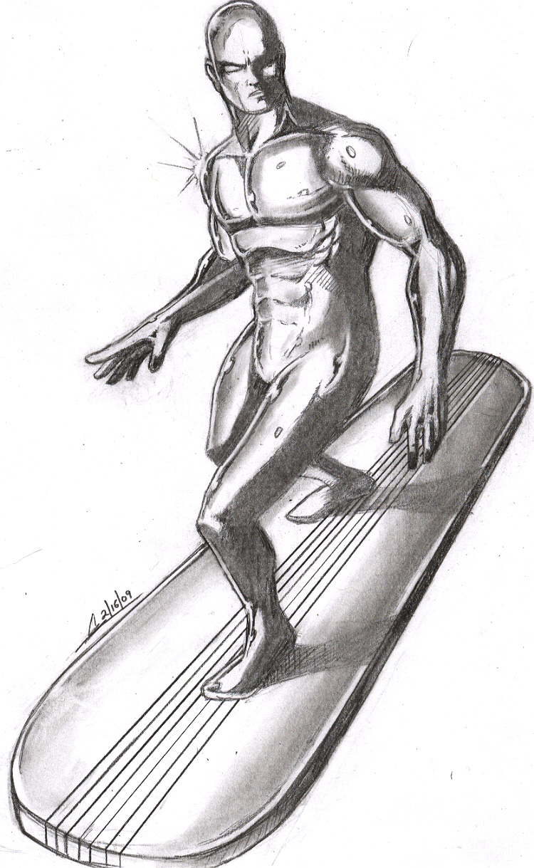
The random surfer of the Web
Random surfer’s algorithm
Start: choose a random page on the Web
Follow links: choose between them randomly
Keep going on for ever
In a dead-end: choose a random page on the Web
Popularity of a page: probability for a surfer to be in a page after an infinite time
High probability for popular pages
How can we compute this popularity?
Introduced by Brin and Page: PageRank

Slide 26
Transfer matrix
G(i,j) = 0 if there is no link from page i to page j;
G(i,j) = 1/n_{i} otherwise, with n_{i} the number of outgoing links of page i
G =
0 | 1 | 0 | 0 | 0 | 0 | 0 | 0 | 0 | 0
0 | 0 | 1/4 | 0 | 0 | 1/4 | 1/4 | 0 | 1/4 | 0
0 | 0 | 0 | 1/2 | 1/2 | 0 | 0 | 0 | 0 | 0
0 | 1 | 0 | 0 | 0 | 0 | 0 | 0 | 0 | 0
0 | 0 | 0 | 0 | 0 | 1/2 | 0 | 0 | 0 | 1/2
1/3 | 1/3 | 0 | 1/3 | 0 | 0 | 0 | 0 | 0 | 0
0 | 0 | 0 | 0 | 0 | 1/3 | 0 | 1/3 | 0 | 1/3
0 | 1/3 | 0 | 0 | 0 | 0 | 0 | 0 | 1/3 | 1/3
0 | 1/2 | 1/2 | 0 | 0 | 0 | 0 | 0 | 0 | 0
0 | 0 | 0 | 0 | 1 | 0 | 0 | 0 | 0 | 0

Slide 27
Popularity transfers
1/2
3
9
1/2
1/4
1/4
4
2
1
1
1/4
1/4
1/3
1/3
6
5
8
1/3
7
10

Slide 28
Computing the popularity of pages
We consider the fixpoint equation
Pop = G^{T .} Pop
If the graph is strongly connected and aperiodic, this can be computed as the limit when k goes to ∞ of
Pop_{k} = (G^{T} )^{k .} Init
for some initial column vector Init, say
Init = [1/10, 1/10, 1/10, 1/10, 1/10, 1/10, 1/10, 1/10, 1/10, 1/10]
Then, Pop(i) is the probability that the surfer is in page i after an infinite time

Slide 33
The fixpoint is reached

Slide 34
Issues
The graph is not strongly connected
Introduce a damping factor to fix this “amortissement”
Replace Pop_{k} = (G^{T} )^{k .} Init
By Pop_{k} = ((1-d)G^{T +} dU)^{k .} Init
where U is a matrix with 1
Interpretation: add thin edges between all edges of the graph

Slide 35
Ranking pages in practice
Rank by weights based on several criteria
E.g., weight(t,d) = tfidf(t,d) × Pop(d)
Many more criteria in Google
Issue of the bad guys

Slide 36
Fighting the bad guys

Slide 37
Spamdexing the old fashion style
Lying about the document to bring readers to a page
Include words that are not related to the page content
Typically make them invisible, e.g. blank on blank
In meta-information such as
<meta name=“Aretha Franklin Ray Charles Elvis Presley Sam Cooke John Lennon Marvin Gaye Bob Dylan Otis Redding Stevie Wonder James Brown”>
Countermeasure
Detect invisible text and ignore it
Ignore meta-information unrelated to the page content

Slide 38
Spamdexing a little old fashioned
Pollute existing websites (typically blogs, wikis) by adding links to the spamdexer website
Countermeasures
Control who can write in the blog/wiki/etc.
(require validation)
Detect pollution and block it
Disallow indexing

Slide 39
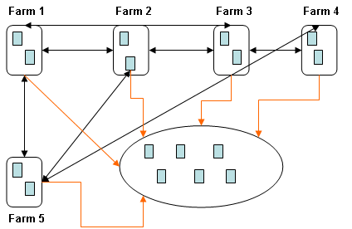
Spamdexing the modern way
Use link-farms to artificially raise the popularity of your page
Countermeasures:
detect link-farms
E.g. brutal PageRank variations
Bizarre content
This is not easy
Use less PageRank
Alternative ranking such as TrustRank

Slide 40
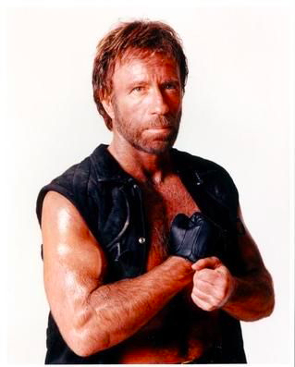
Bombing
Try querying “find Chuck Norris” in Google, Exalead…
The first result page contains
Google won't search for Chuck Norris because it knows you don't find Chuck Norris, he finds you.
Your search - Chuck Norris - did not match any documents.
Suggestions:
Run, before he finds you.
Try a different person.
Try someone less dangerous.
To do that: people created many pages pointing to that page with a text “find Chuck Norris”

Slide 41
Jewel: the OPIC Algorithm
Work with Gregory Cobena, Mihai Preda & Laurent Mignet
Used in the INRIA-Xyleme crawler with up to a billion URLs

Slide 42
On-line vs. off-line computation
Off-line algorithm
Crawl the Web and build a Link-matrix
Store the link matrix and update it – very expensive
Start an off-line computation of popularity on a frozen link matrix
On-line algorithm: OPIC
for On-line Page Importance Computation
The storage of the link matrix is not needed
An estimate of popularity is computed while crawling and continuously updated

Slide 43
Static Graphs: OPIC
Start with a set of pages
Assign to each page a small amount of cash
Choose arbitrarily a page
Read the page (it may have changed on the Web)
Distribute its cash equally between its children
If it has no child, distribute it equally between all pages
The total of cash in all pages does not change

Slide 44
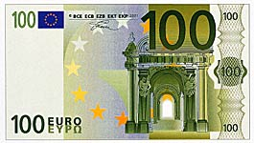
Example: Small Web of 3 pages
Alice
A
Bob
Georges
B
G

Slide 45
OPIC-popularity
Definition: the OPIC-popularity of a page is the flow of cash in the page
Thm: OPIC-popularity is the same as PageRank-popularity
(at the limit)
Issue: speed of convergence
The sum of the cash a page received
________________________________
The sum of cash all the pages received
OPIC-Pop(page) =

Slide 46
Advantages
Requires less resources: no need to store the Web graph
Computes popularity of newly discovered pages while crawling
Use it to decide what to crawl: the most popular ones
Continuously adapt to changes (new pages, page updates)
Consider only the flow in a page “recently” (time window)

Slide 47
Experiments (2)
Crawler
Up to 100 robots running simultaneously on a single PC
Average of 50 pages/seconds on an (old)PC (4 millions/day)
Limiting factor was the number of random disk access
Performance and Politeness
Pages were grouped by domain to minimize the cost of DNS (Domain Name Server) resolution
To avoid rapid firing, we maintained a large number of accessible sites in memory (1 million domains).
Knowledge about visited pages: 100 million pages in main memory
For each page, the exact disk location of the info structure (4 bytes) + a counter that we use for page rank and for the crawling strategy
One disk access per page read

Slide 48
Conclusion

Slide 49
Web search engine
The crawler to visit the Web
The index with heavy use of parallelism
The ranking based on popularity and other measures

Slide 50
There is much more
Fagin threshold algorithm for combining AND results
retrieving top-k results with minimal access to the lists for each keyword
Boolean queries And/Or/Not
Clustering answers
Searching images and in general multimedia
Search taking user preferences into account
Search taking time into account: e.g., alerts for new documents
Search taking space into account: e.g., based on user location

Slide 51
And beyond
Negative references
In recent news: A service company ranked first with mostly negative references
Today’s technology is simplistic
Input: some keywords
Output: pages that contain these word
Move to more semantics and structured data
Semantic Web: already discussed
Hidden Web
part of Web content that lies in online databases
typically queried through HTML forms
not usually accessible by following hyperlinks
Huge
☛ Richer syntax
☛ Precise answers

Slide 52
Non technical issues
Search engine are perhaps becoming less essential
Social networks: opinions and recommendations
Search engine are perhaps too powerful
Almost monopoly by a few players
Enormous power: you disappear if you are not high on the list
The secrecy over the page ranking functions of search engine is questionable
P2P search engines?

Slide 53
References
Sergey Brin and Lawrence Page, « The anatomy of a large-scale hypertextual Web search engine. » Computer Networks, 1998.
Serge Abiteboul, Ioana Manolescu, Philippe Rigaux, Marie-Christine Rousset et Pierre Senellart, « Web data management », Cambridge University Press, 2011 : www.webdam.inria.fr/Jorge
Serge Abiteboul, Mihai Preda et Grégory Cobena, « Adaptive On-Line Page Importance Computation », WWW Conf. 2003.
Alban Galland, Serge Abiteboul, Amélie Marian et Pierre Senellart, « Corroborating information from disagreeing views », Conf. WSDM 2010.

Slide 54
Merci !
5/3/12
5/3/12
54
54

Slide 55
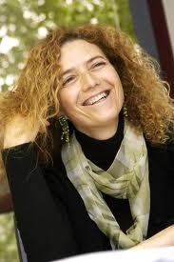
Tova Milo
Full professor at Tel Aviv university
Department head
Research
advanced database applications (data integration, semi-structured information…)
Web-based applications and Business Processes
Program Chair of PODS, ICDT, VLDB…
Member of the VLDB Endowment and the ICDT executive board
2010 ACM PODS Test-of-Time Award
ERC Advanced Investigator grant

